Slide 1

BPS ANALYTICS
RECOMMENDATION ENGINE
Roadmap & Framework

Slide 2



Industry challenges
High cost of servicing customers is a pain point for telecom/retail/BFSI
How to be operationally efficient and profitable ??
Trust in partner’s ability to provide digital ROI
Reliability of data and insights generated is generally questionable
Limited success in embracing digital technologies specifically Advanced Analytics and AI

Slide 3
KPI level issues for BPS implementation
Customer satisfaction
Operational excellence
Revenue assurance
How to increase product penetration at household level ?
How to drive NPS in right direction ?
How to capture customer voice effectively ?
How to acquire and retain customer ?
Who should be contacted through which channel ?
No Single version of Truth (SVOT) in DATA ?
Forecast calls, complaints, agents and optimization challenges?
Who are the most likely payment defaulters?
How to improve collection ?
Right pricing for right customer segment ?
How to reduce repeat calls and increase FCR ?
How to improve AHT, TAT for complaints ?

Slide 4

Our Solution: BPS-RE
Leveraging best in class, proven industry solutions
Tool-agnostic solution leveraging industry benchmarks
Real time decision making from Data
Integrated advanced analytics and RPA solutions
Robust delivery methodology with predictable outcome

Slide 5
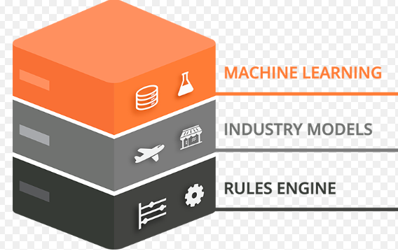

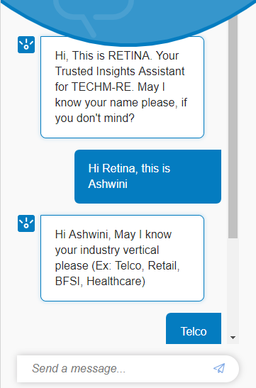










BPS-RE : Recommendation Engine
Customer Profile
Understand Business needs
Smart Visualization
Suggest best interventions
RE (Predictive + Prescriptive) (AI Engine)
NPS
Customer Churn
Cross-Sell /
Up-Sell
FCR
Remediation
Retention Offers
Recommendation
CONSULTING
ANALYTICS & ROBOTICS
AUTOMATION (CLOUD + ETL + ML + BIG DATA +VISUALIZATION + DEVOPS + CI/CD)

Slide 6




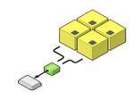

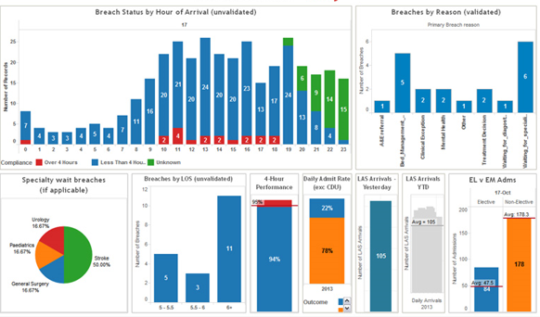


How RE works
Data Ingestion from:
RDBMS
Big Data Sources (Cloudera)
MongoDB
CSV Files / Flat Files
Churn
Service Desk
Telecom
Customer Experience
FCR
Retail
Supply Chain
BFSI
Finance & Accounting
Health & Life Sciences
Interact Over Web, Desktop, Smartphone
NPS
Industry Analytics
Cross-Sell / Up-Sell
Analytics
Engine
Recommended
Key Risks drivers / Key Metrics
Feature
Engineering
Model
Building on
Multiple Platform
(R, Python, AWS)
Model
Comparison
Smart Visualization
Model Automation – Self Learning

Slide 7
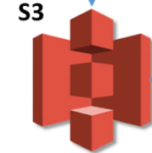
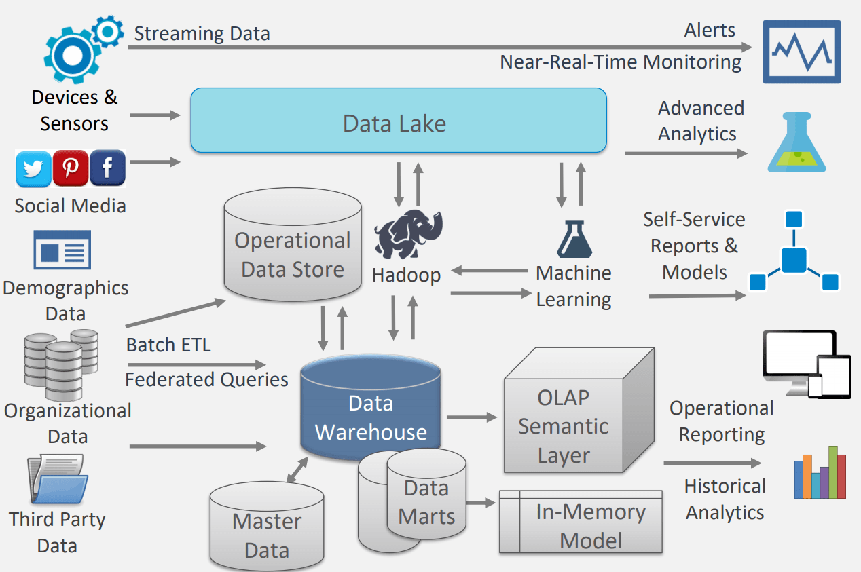


















BPS-RE:FUTURE ARCHITECTURE
Web based app (Powered by ChatBot/VoiceBot Assistant)
CLIENT DATA SOURCES
** RE (AI CORE ENGINE + DATA LAKE )
SMART VISUALIZATION
Calls
Chat support
TONE ANALYSER
Dialler Data
Chat Data
BATCH LOAD
DAILY LOAD
REAL-TIME
Raw data
Enriched data
Model + Prediction
Recommended KPIs, Reports and Dashboards
Service Desk
Usage
Service
Usage Data
Predictive
and
Prescriptive Analytics Results
ETL
Amazon Glue
Billing
Agent 360
Billing Data
Agent Performance
AI CORE ENGINE
** RE data lake and core engine is displayed for AWS cloud indicatively.
Similarly, it will be offered for other Cloud/ On-premise Tech stacks
SageMaker/ R / Python/ Scala
Customer
PARTNER SOLUTIONS INTEGRATION
Customer Data
AUTOMATION SOLUTIONS (RPA + DEVOPS)
ON CLOUD
+
ON PREMISE

Slide 8
BPS-RE
PRESENT ARCHITECTURE

Slide 9
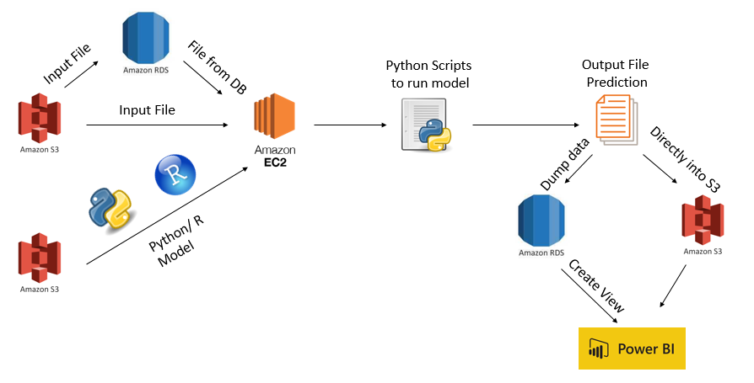

Slide 10


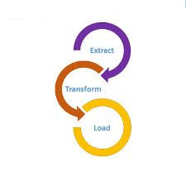


TECHNOLOGY CONFIGURATION
Hosting
ETL
Visualization
AWS
Azure
Megham
On-premises
Other Cloud
AWS Glue
Azure Datafactory
SSIS
Sqoop
Others
Power BI
Tableau
Zoom
Others
Big Data
ML Engine
AWS EC2
AWS S3
AWS EMR
HDP on AWS
Azure HD Insight
HDP On-premises
AWS Sagemaker
Python
R
Azure ML Studio
Spark MLib
H2O

Slide 11
RE Framework Development & Deployment Timelines
Phase | Use Case | Prediction Model | Projected Dates
Phase I | Customer Retention | Customer Churn Prediction | Oct-19
 | Reduction in contact volume | Contact Issue path analysis
 |  | Best time to call customer
 |  | Propensity to pay bill in time
 |  | Repeat call prediction
Phase II | NPS Improvement | NPS Prediction model | Dec-19
 | Bill Realisation | Text mining of customer feedback
 | Order Management | Order Fallout prediction
 |  | Order rework/delay analytics
 | Sales fraud | Fraud detection - Customer initiated or sales person initiated
 | Truck roll optimisation | Truck roll analytics
Phase III | Reduction in planning inaccuracy for infra work | Prediction model for exceeding planned budget | Mar-20
 | Concession/Fraud | Invalid concession prediction
 | Revenue Enhancement | Product association analysis
 | Revenue recognition | Invoice payment prediction
 | Persistency analytics | Insurance premium payment prediction

Slide 12
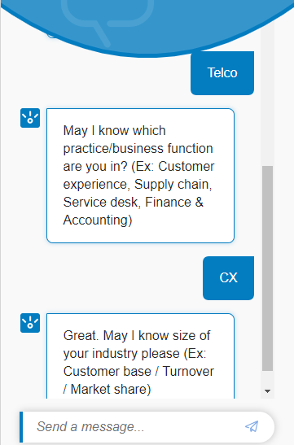
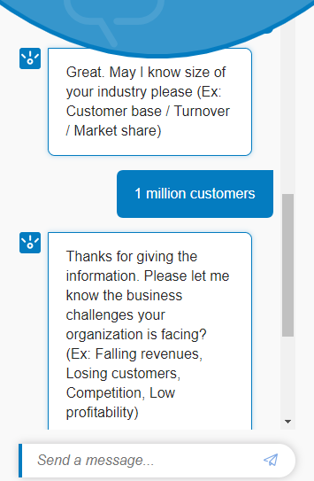
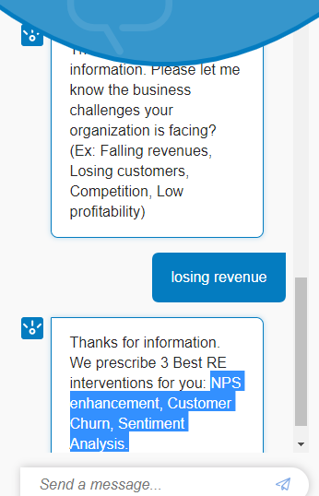
RETINA (Recommendation Engine Trusted INsights Assistant)
RETINA
RETINA
RETINA
RETINA
Please try RETINA chatbot at: https://assistant-chat-au-syd.watsonplatform.net/web/public/4438db1f-32c7-4626-a2f9-348fc43a8ba9
Please try RETINA VoiceBot at: https://bot.dialogflow.com/29173db6-065f-4b0e-81e7-81834fe87dbd
CONSULTING + AUTOMATION + ANALYTICS (Domain expertise + NLP + AI BOTs )

Slide 13
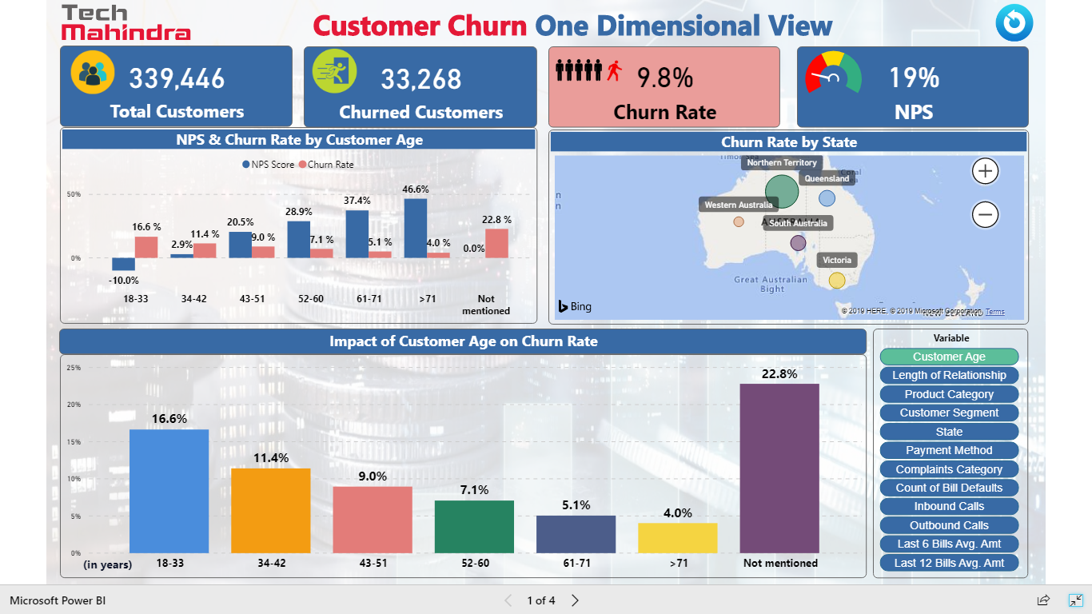
SMART VISUALIZATION – Illustrative

Slide 14
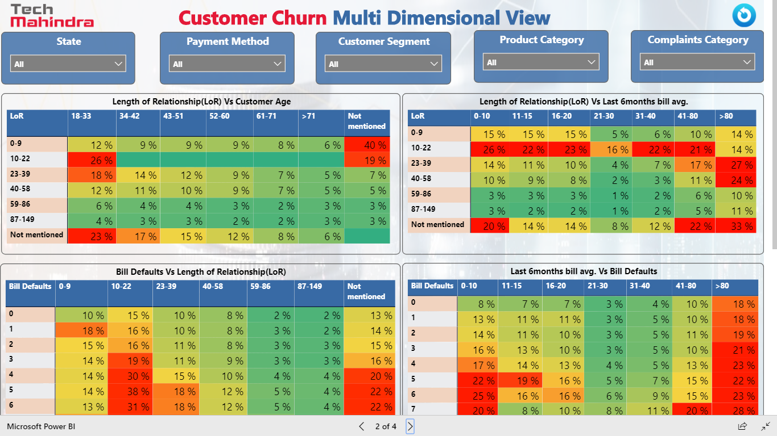
SMART VISUALIZATION – Illustrative

Slide 15
How we take it to market
Product
Price
Place
Promotion
People
USP - First Global BPS-centric RE Product
Competition
Indirect competition with Next-gen BPS Frameworks of Genpact, EXL, WNS
Direct competition with Accenture AAP, IBM TELUS
25K USD for simple use case
Followed by Enterprise model including CoE
Existing clients
New clients in US, UK, Australia and Europe
Self-service Demo for a Rainmaker
Digital media marketing
Client workshops
Tech summits
5 FTE for product development
1 dedicated SPOC for each target Geo

Slide 16
BPS-RE: MVP Roadmap
Identify customers, focus areas and 1-2 use cases for MVP
Identify data and infra requirements
Development stack and Partner tools
Formulate business rules
Back-end workflow & design
Frontend workflow & UX/ UI design
Chabot workflow & design
Access/ Technology setup
Identify data sources and collect data
Build application front-end and Chabot
Build data pipeline
Build RE engine
Integrate partner tools
Integrate front-end and back-end
Build deployment scripts
Deploy on pre-prod setup
Test cases
Functional test and validate
Performance test
Data integrity & security test
Re-configure
Re-Test
Deploy in Self-service model
UAT
Re-configure with stakeholder inputs
Re-deploy
Pricing/ RoI models
Demos/ Videos for Rainmakers
Roadshows/ Tech summits/ Client workshops
Digital Marketing
Roadmap Snapshot
DURATION
~4-5 Months including GTM
Phase 3
DEPLOY
2 weeks
Phase 4
GTM & GO-LIVE
(4-6 weeks)
PEOPLE
4-5 Resources
Phase 2
PRE-PROD & TEST
2 weeks
Phase 0
ANALYSE & DESIGN
4 weeks
Phase 1
BUILD & INTEGRATE
6-8 weeks

Slide 17

BPS-RE MVP Team
X 5
Roles includes Product Manager cum Architect, ETL cum Data modeler, BI & Visualization developer, Data Scientist, Web app developer
Major Skillsets
Product Manager cum Architect: Responsible for Product design and dev planning and management, Responsible for all technical aspects of a system integration, quality system design, productivity of team, ensuring effective development environment and handling all technical issues.
ETL Lead cum Data modeler: Responsible for designing and creating the data warehouse/mart/data model and all related extraction, transformation and load of data functions.
Data Scientist: Responsible for identifying AI/ ML algorithms and tools, deal with complex algorithms, train and deploy models and help Data owners put their data to use in overall product
Web Developer: Responsible for front-end UI/ UX design and development and integration with back-end
BI Reports and Visualization developer: Development of BI reporting and visualization layer and support integration of same with web application front end

Slide 18
BPS-RE: Full-scale Product Roadmap
Analyze VoC
Improve design and UX
Identify other use cases
Identify data and infra requirements for a scale-up
Design technical and deployment architecture for scaled-up requirements
Infra and Tech ramp-up
Resource ramp-up
Design, Develop and Automate all use cases
Integration with Partner solutions
Pre-prod deployment and Test
Re-config & Re-deploy
Deploy in Self-service model
UAT
Re-configure
Re-deploy
Demos/ Videos for Rainmakers
Roadshows/ Tech summits
Client workshops
Digital Marketing
Roadmap Snapshot
MVP Live Service
DURATION
8-9 Months including GTM
MVP Live deployment for customers
MVP Live service management
MVP validation through Customer feedback
Capture VoC
Phase 3
DEPLOY
4 weeks
Phase 4
GO-LIVE & GTM
(8 weeks)
PEOPLE
10 Resources
Phase 2
SCALE-UP & TEST
16 weeks
Phase 1
IMPROVE
8 weeks
LEARN

Slide 19
BPS-RE Product: Team Structure
X 10
Roles includes Product Manager, Technical Architect, Business Analyst, Data Scientist, ETL Lead cum Data Modeler, Big Data Consultant, Data Base Administrator, UI/UX developer, ETL developers
Major Skillsets
Product Manager: Responsible for Product design and dev planning and management
Technical Architect: Responsible for all technical aspects of a system integration, quality system design, productivity of team, ensuring effective development environment and handling all technical issues.
Business Analyst: Responsible of interacting with business stakeholders to gather the system requirement, analyze the business needs and documents the requirements.
Big Data Consultant: Responsible for aggregating data from multiple sources in an efficient data warehouse/mart and building enterprise-level solutions.
DBA: Responsible for designing the database schema and data objects. also be involved in the performance, integrity ,security, planning and development of the database.
ETL Lead/Developer: Responsible for designing and creating the data warehouse/mart/data model and all related extraction, transformation and load of data functions. Also provide support in Debugging, monitoring and troubleshooting BI solutions.
Data Scientist: Responsible for identifying AI/ ML algorithms and tools, deal with complex algorithms, train and deploy models and help Data owners put their data to use in overall product

Slide 20
Project milestones
WIP
Stages | Milestone | Deliverables | Time line
Finalizing the Concept (6-7 Weeks) | Requirement Analysis | * Meet with the stake holders and create a detailed Requirement Analysis Document | 1 Week
 | Product Design | * HLD and DLD * Product wireframes * User-flow/Interaction Design * Analytics Framework Design | 5-6 Weeks
 | Branding | * Logo * Color Theme * Creative and Copy | 2-3 Weeks
 | Product UI | * Design for the product | 3-4 Weeks
MVP Development (8-10 Weeks) | Analytics | * Build product relevance model: assign relevant customers needs to agents * Response Models for Customer Acquisition | 8-10 Weeks
 | Backend | * Database Design/Implementation * API Implementation/Integration * Admin Module/CMS * Web App | 8-10 Weeks
 | Web Development | * Website Development * Social Media Integrations through JS | 8-10 Weeks

Slide 21
Appendix-1
Customer Profile
Derives Enterprise needs
Suggests best RE interventions
RE (AI Engine)
Smart Visualization
Industry
Size
Challenges faced
Customer acquisition/ retention/ win-back
Enhance Revenues
Optimize operations
NPS
Customer Churn
First call resolution (FCR)
Cross-sell/ Up-sell
Sentiment Analysis
Data lake
Client Data ingestion
Data enrichment
Feature engineering
ML Model creation, evaluation and tuning
Model deployment
Automatic Model refresh
Recommendations
KPIs / Key Drivers
Recommended prescription on KPIs
Self-service based reporting and dashboards
Auto-refresh of KPIs and Recommendations on ML Model refresh (Continuous Deep Learning)
Feedback data
CONSULTING
ANALYTICS & Robotics
AUTOMATION (CLOUD + ETL + ML + BIG DATA +VISUALIZATION + DEVOPS + CI/CD)

Slide 22
DEMO LINK

Slide 23
DEMO SCREENSHOTS
USE CASE : CHURN

Slide 24
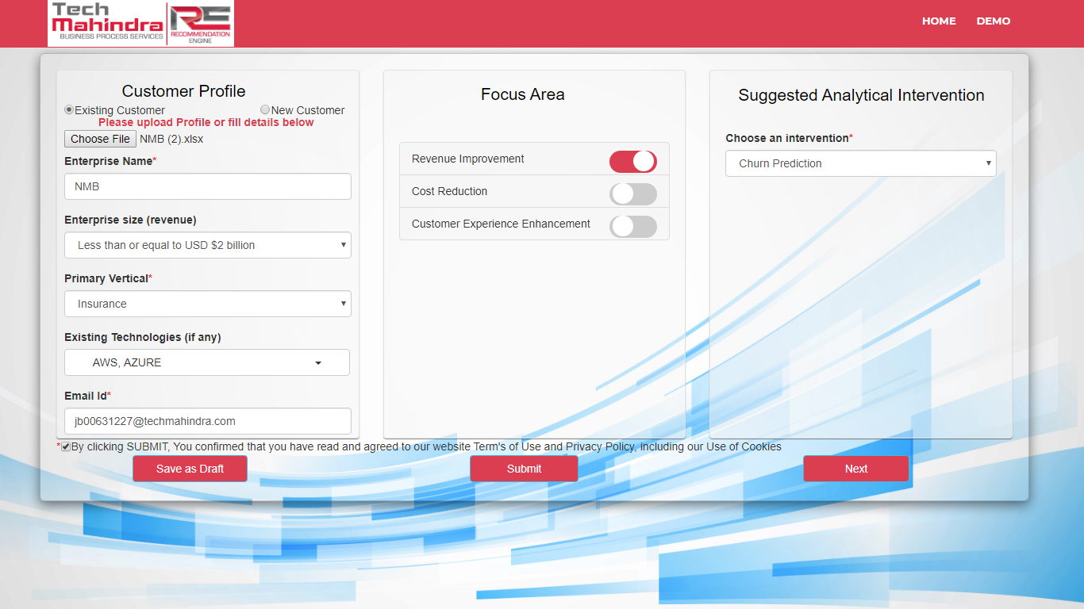
CUSTOMER PROFILE

Slide 25
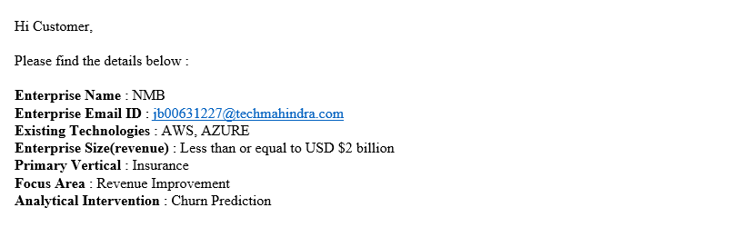

FILLED CREDENTIALS (Email)

Slide 26
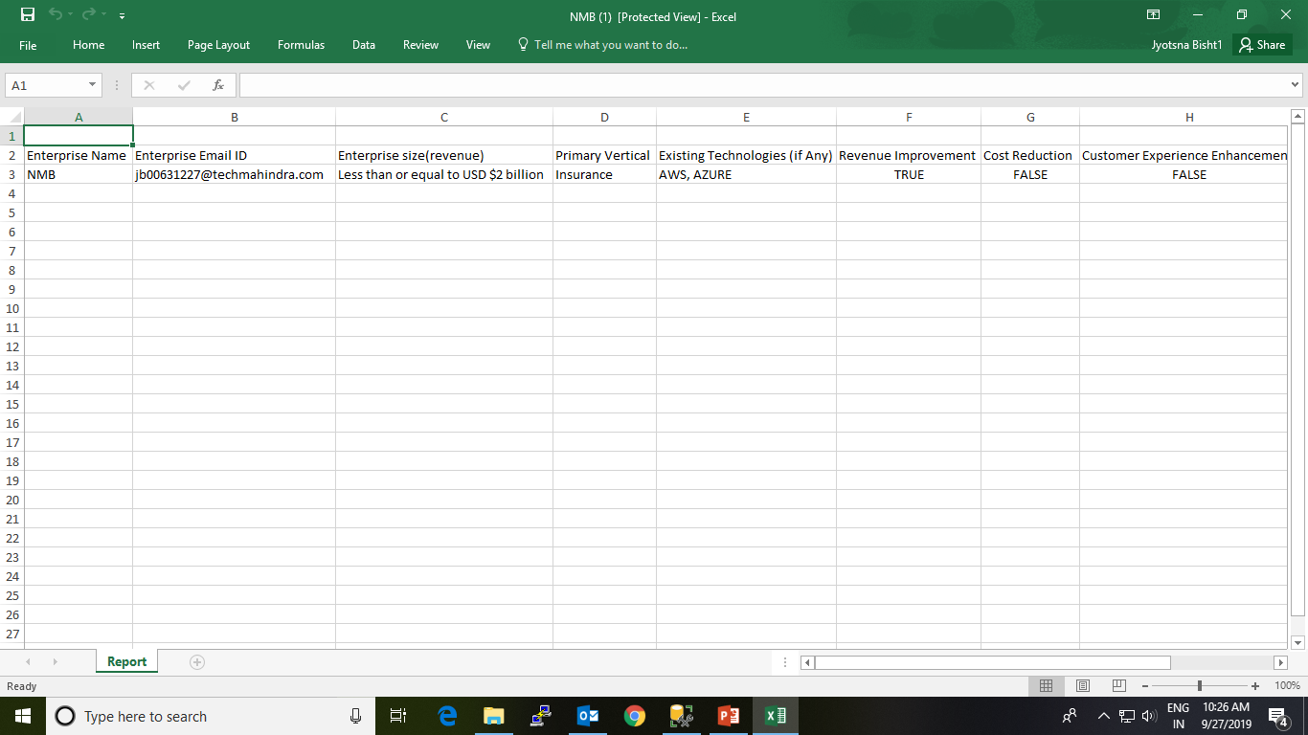
CUSTOMER PROFILE (Downloaded Excel)

Slide 27
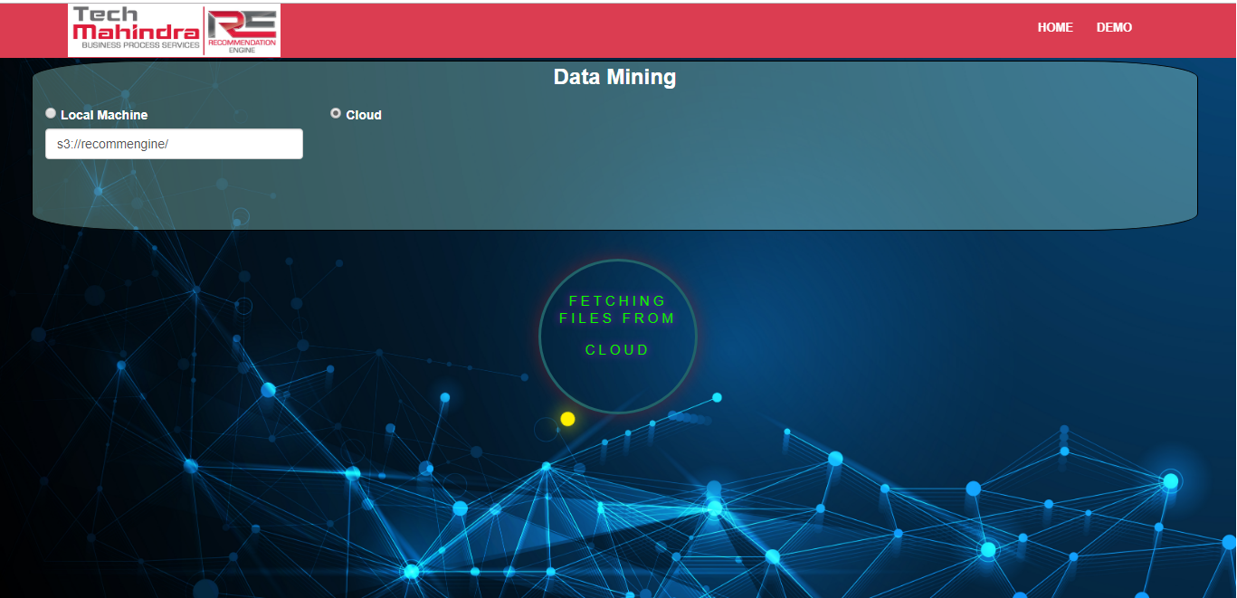
FILE UPLOAD FROM CLOUD

Slide 28
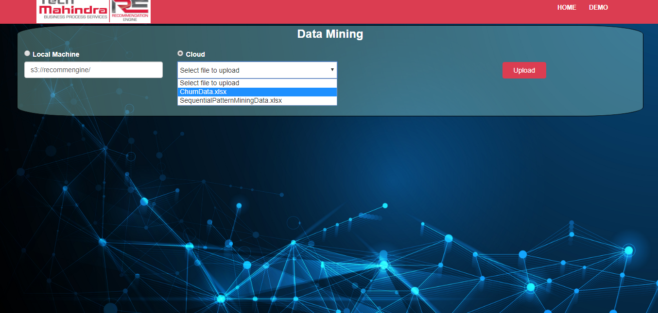

Slide 29
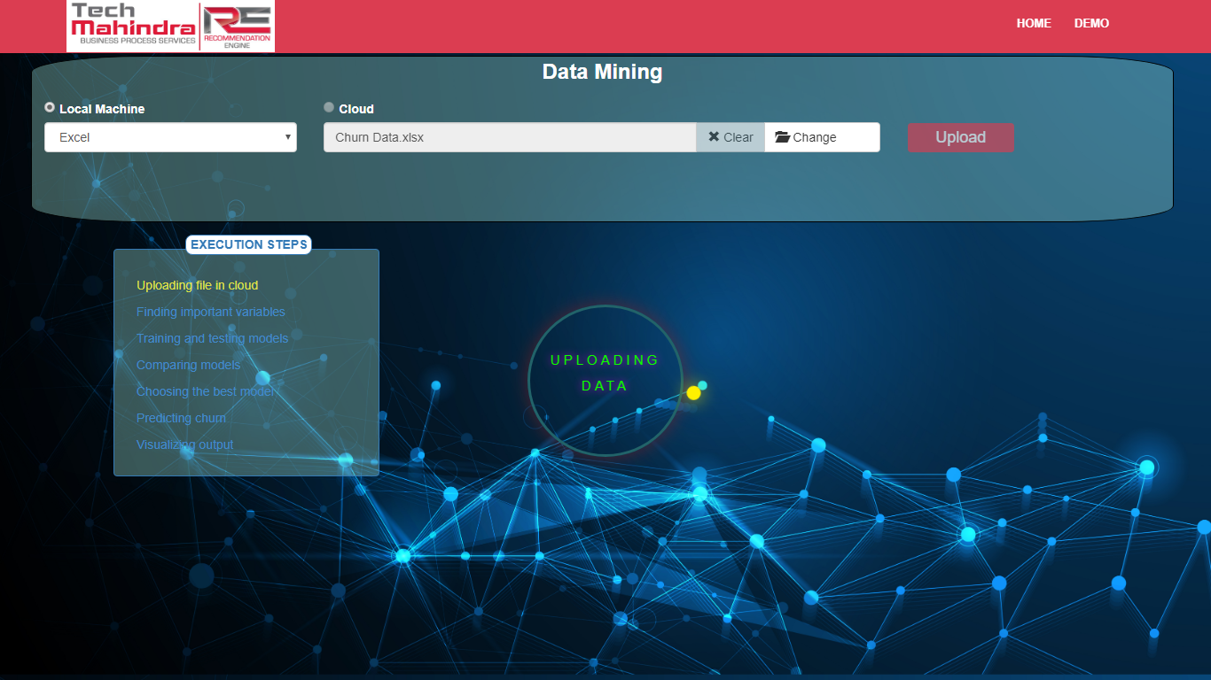
FILE UPLOAD FROM LOCAL MACHINE

Slide 30
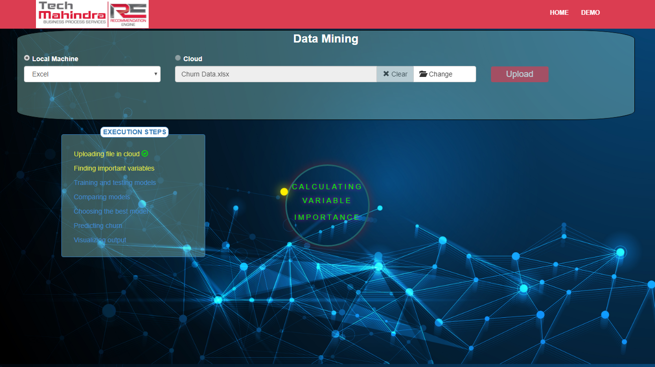

Slide 31
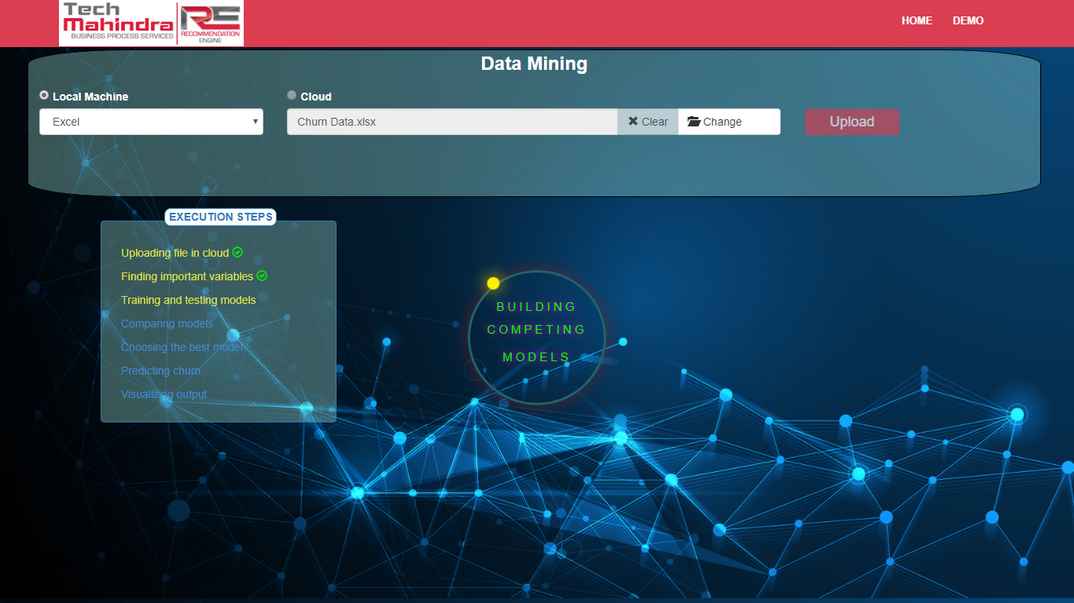

Slide 32
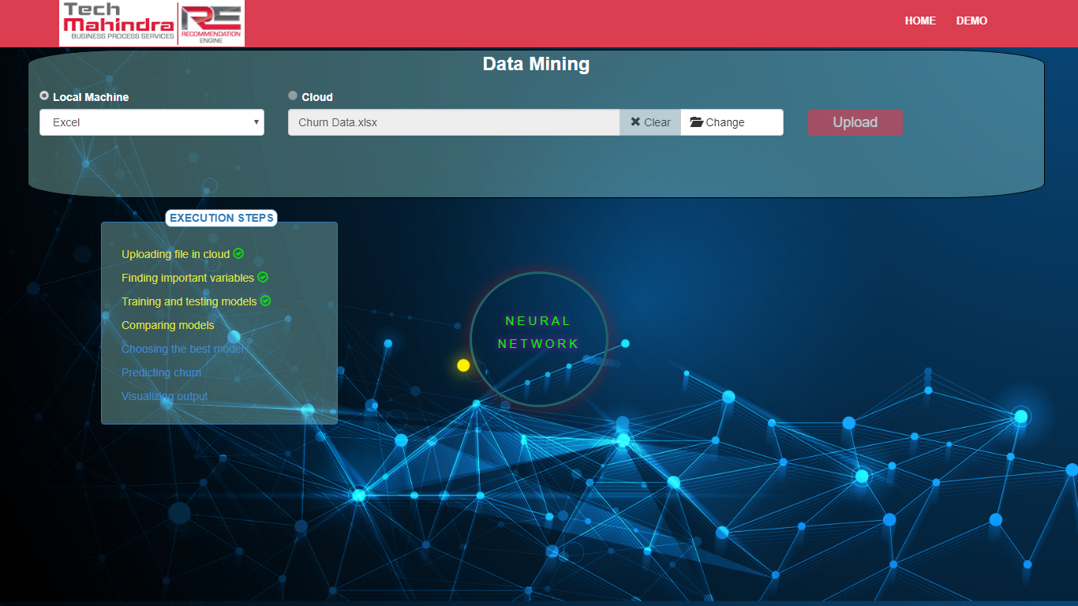

Slide 33


Slide 34
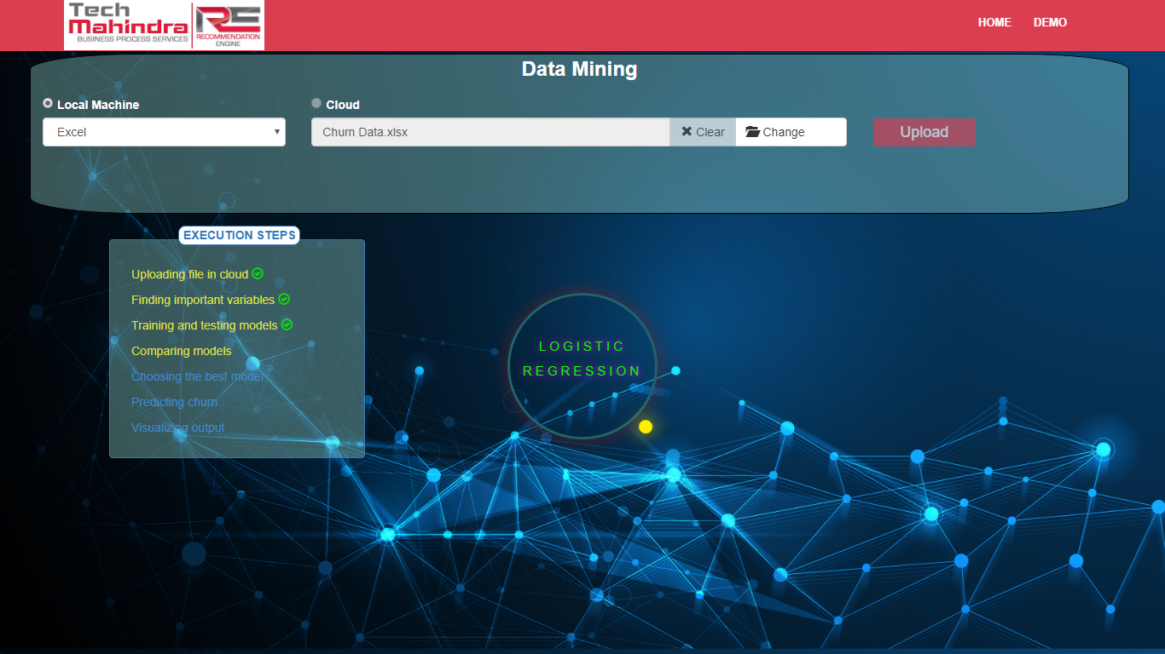

Slide 35


Slide 36


Slide 37


Slide 38
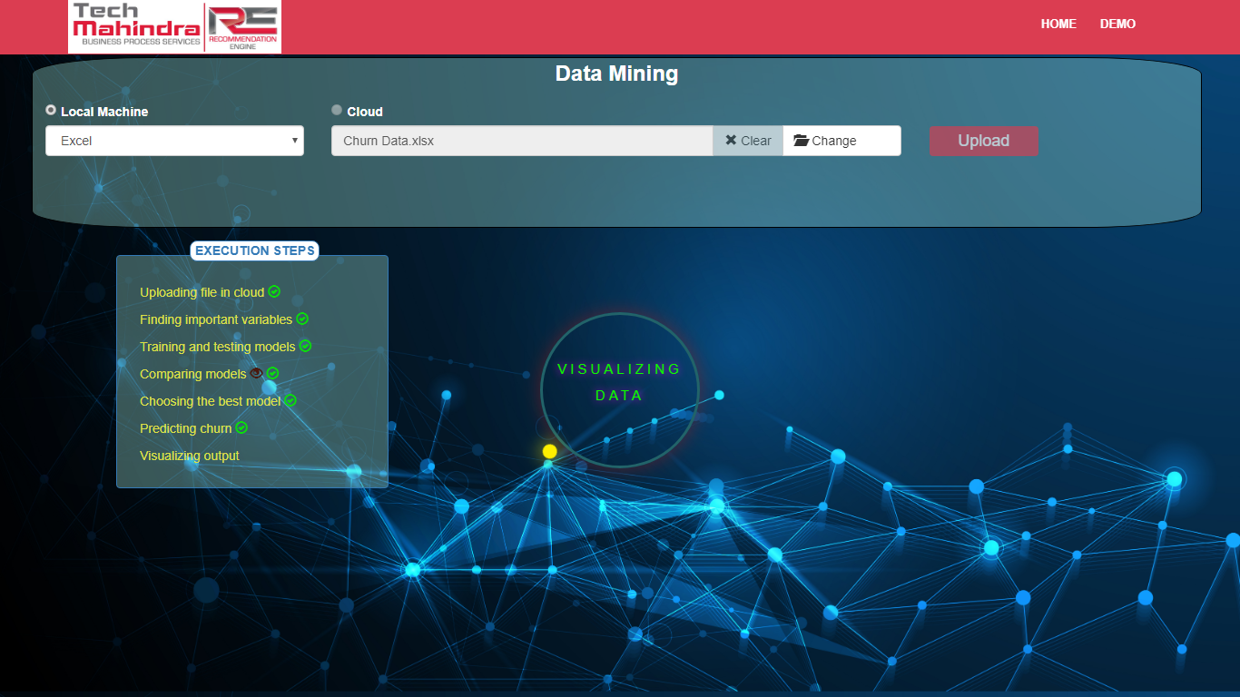

Slide 39
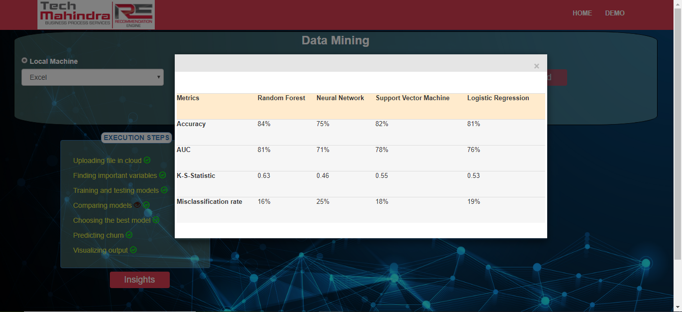
MODEL EVALUATION METRICS

Slide 40
DASHBOARD (CHURN DASHBOARD)

Slide 42
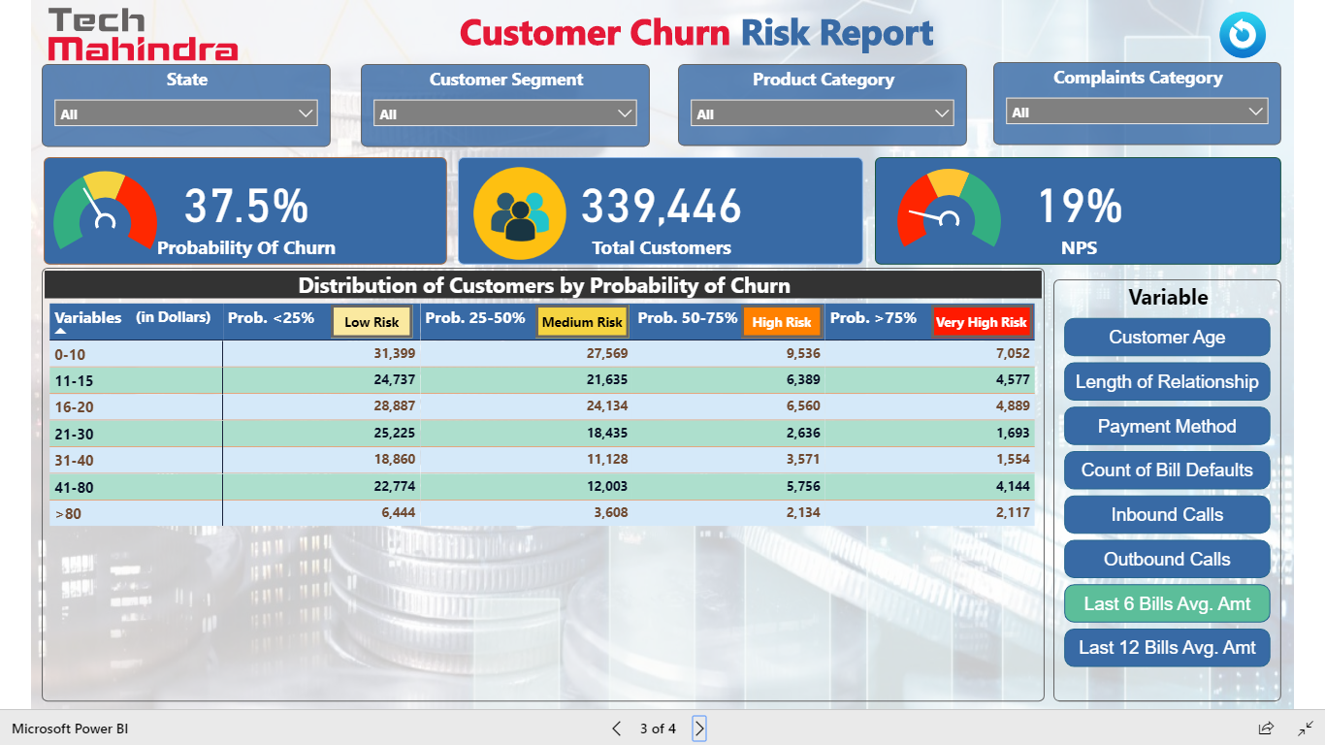

Slide 43
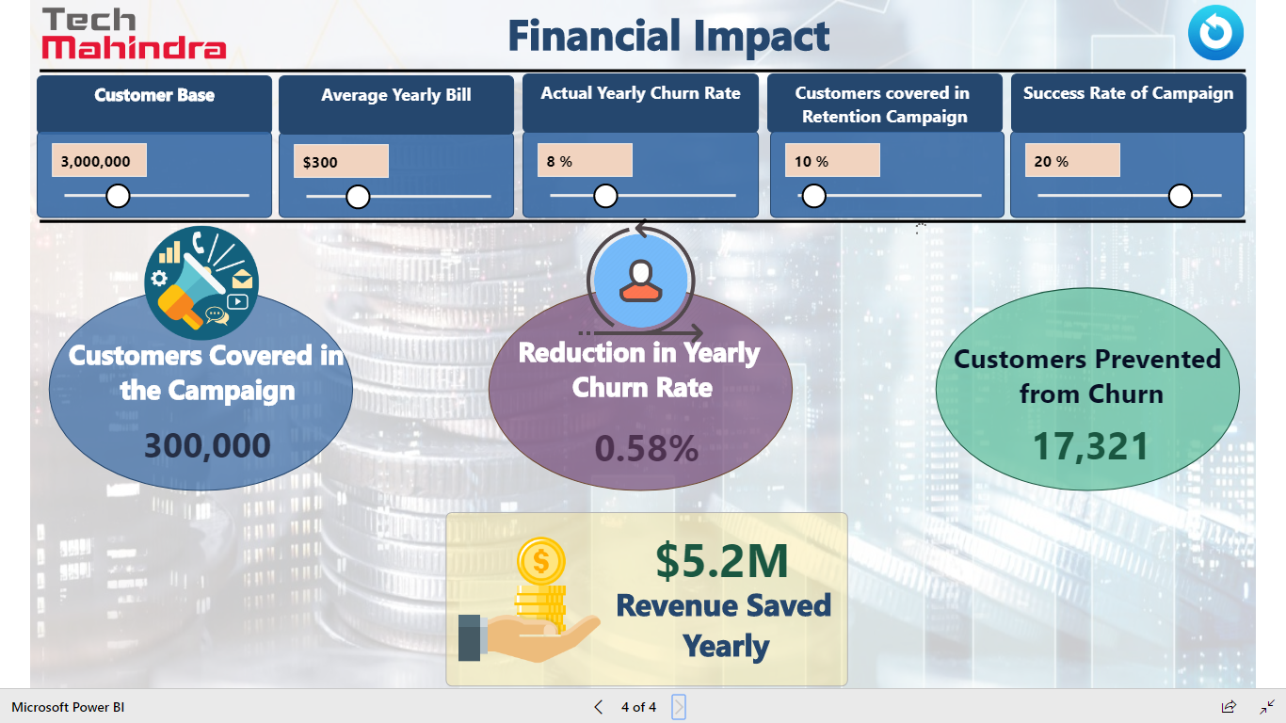

Slide 44
DEMO SCREENSHOTS
USE CASE : CALL VOLUME REDUCTION

Slide 45
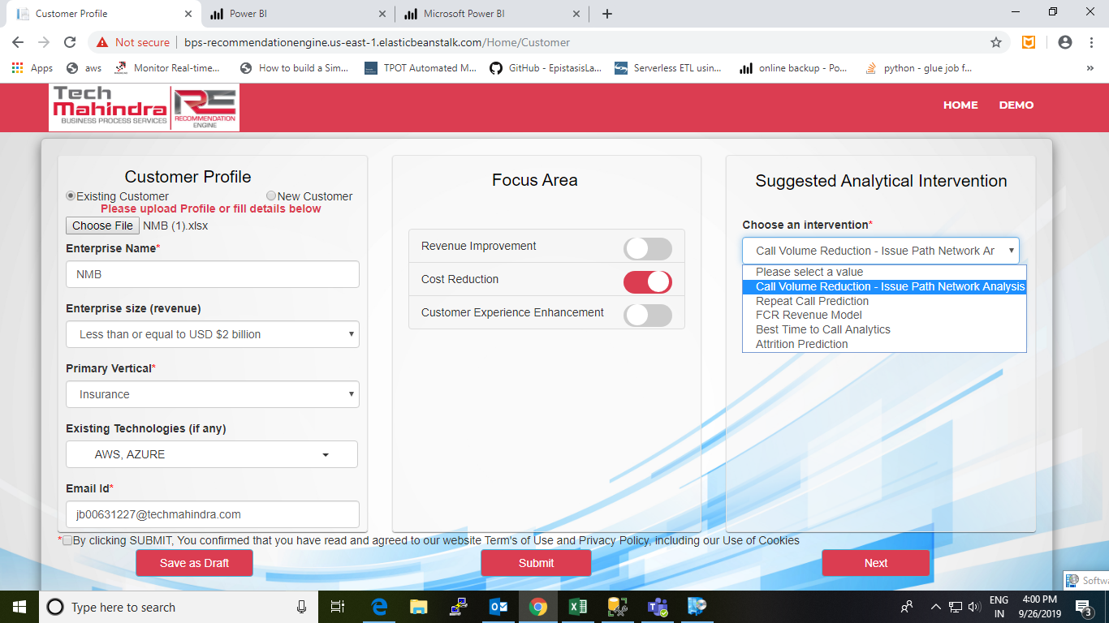

Slide 46
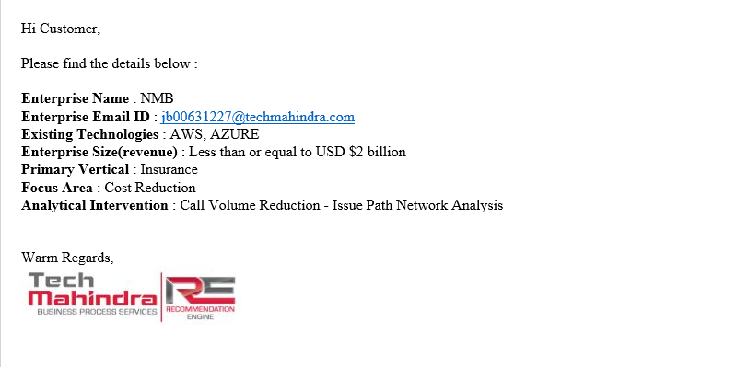
FILLED CREDENTIALS (Email)

Slide 47
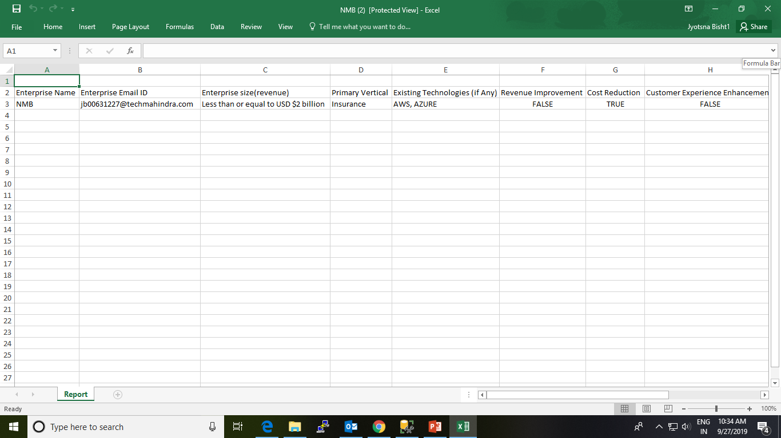
CUSTOMER PROFILE (Downloaded Excel)

Slide 48
FILE UPLOAD FROM CLOUD

Slide 49


Slide 50
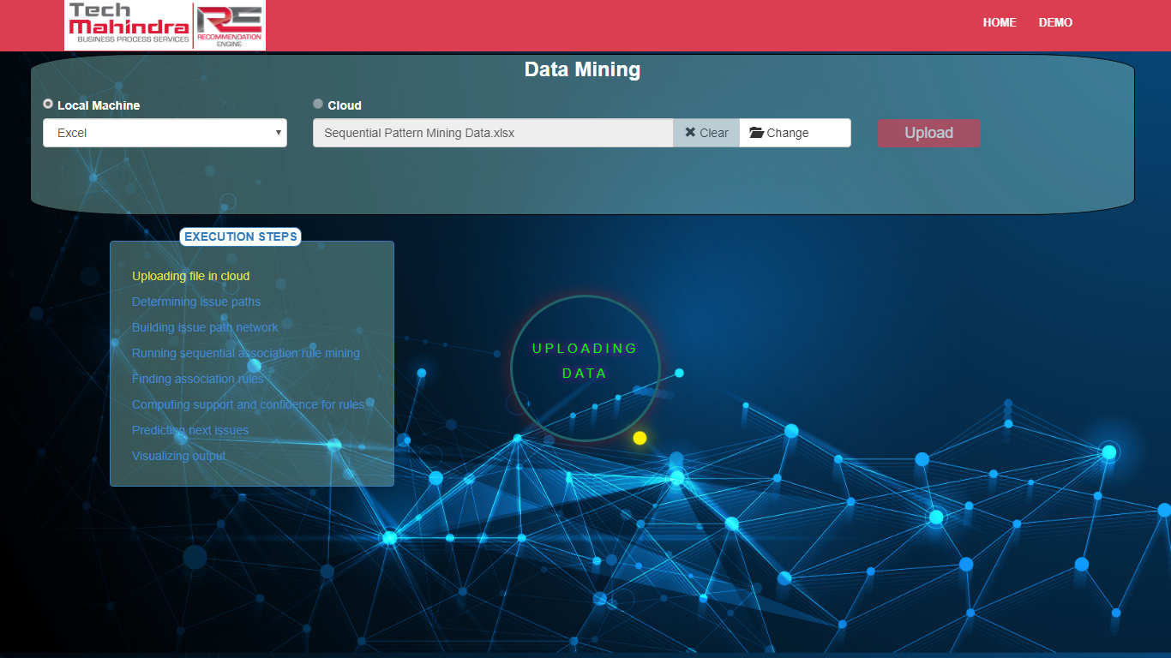
FILE UPLOAD FROM LOCAL MACHINE

Slide 51
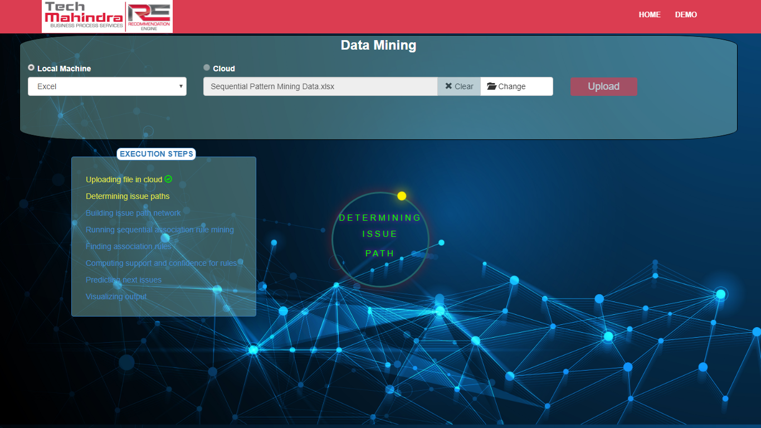

Slide 52
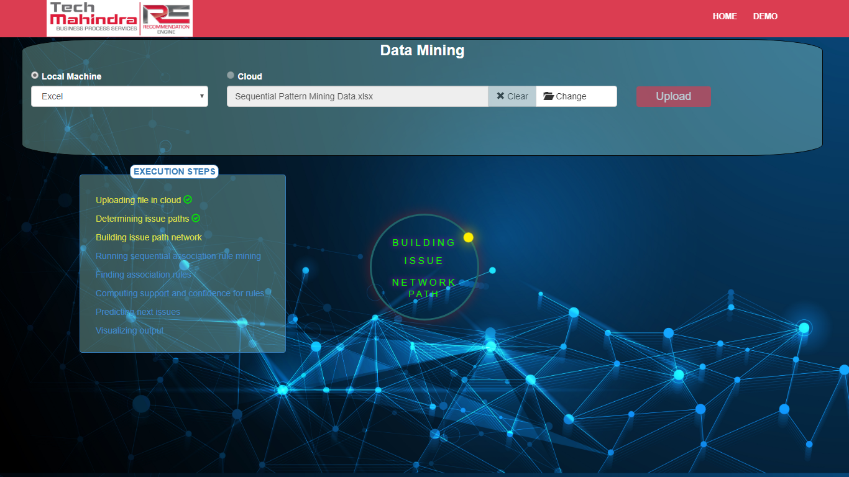

Slide 53


Slide 54


Slide 55
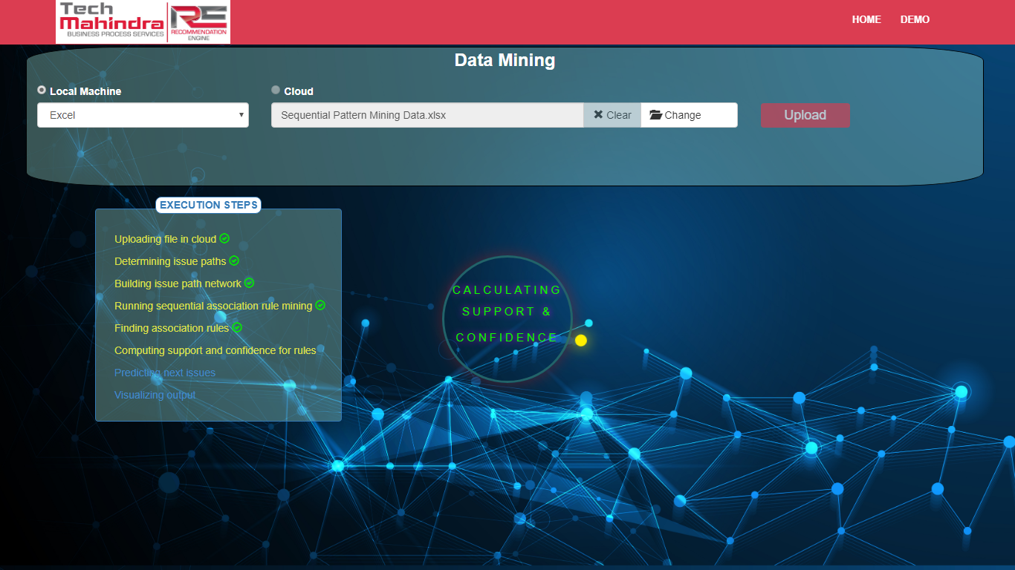

Slide 56
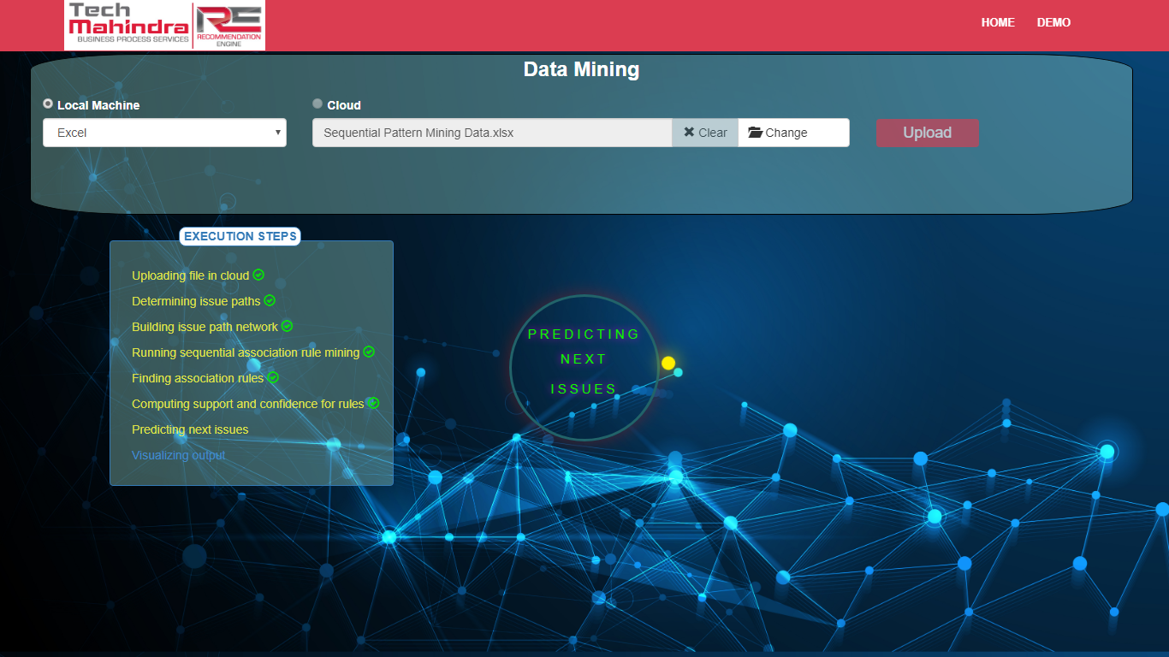

Slide 57


Slide 58
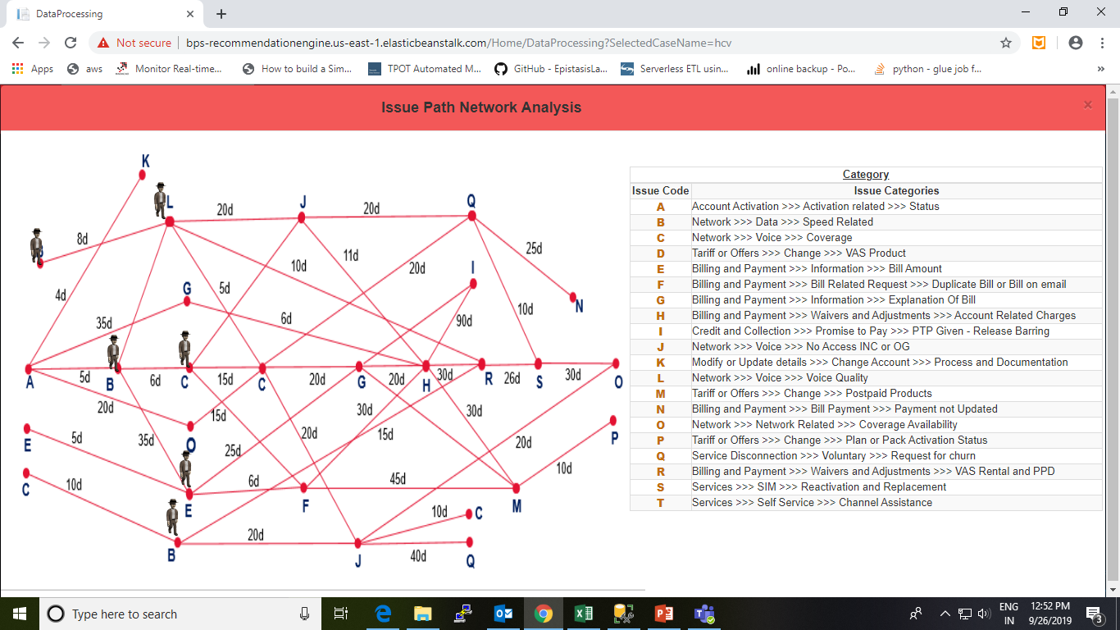
ISSUE NETWORK PATH

Slide 59
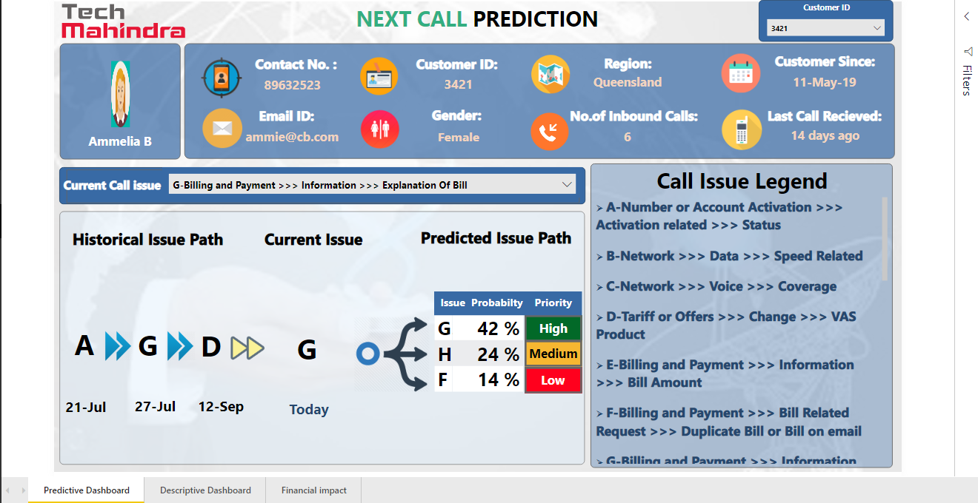
DASHBOARD

Slide 60
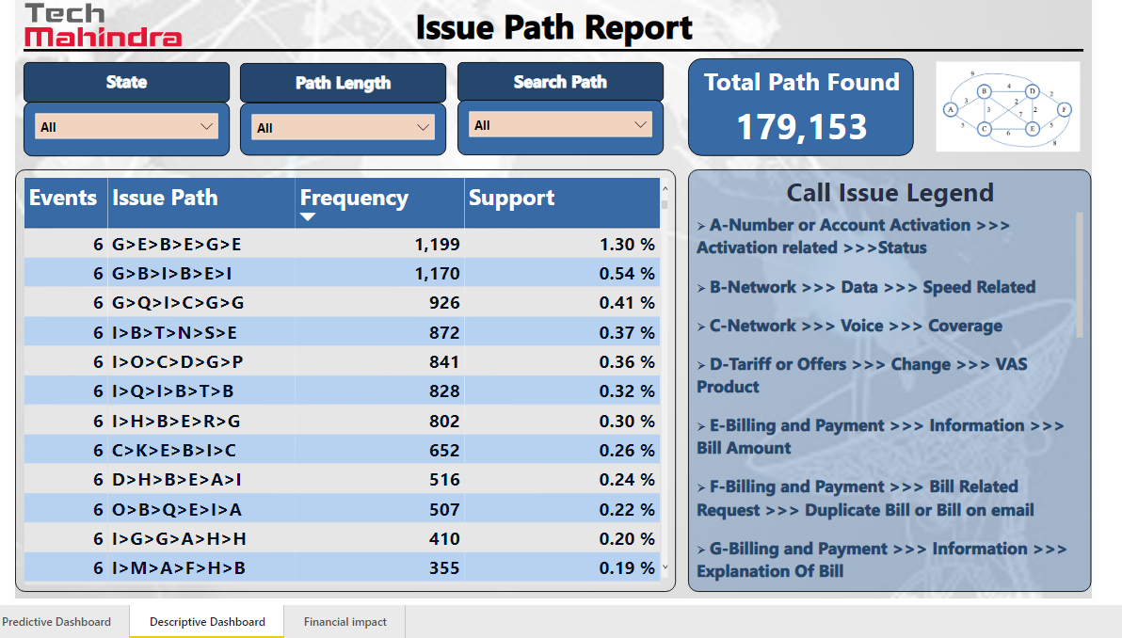

Slide 61
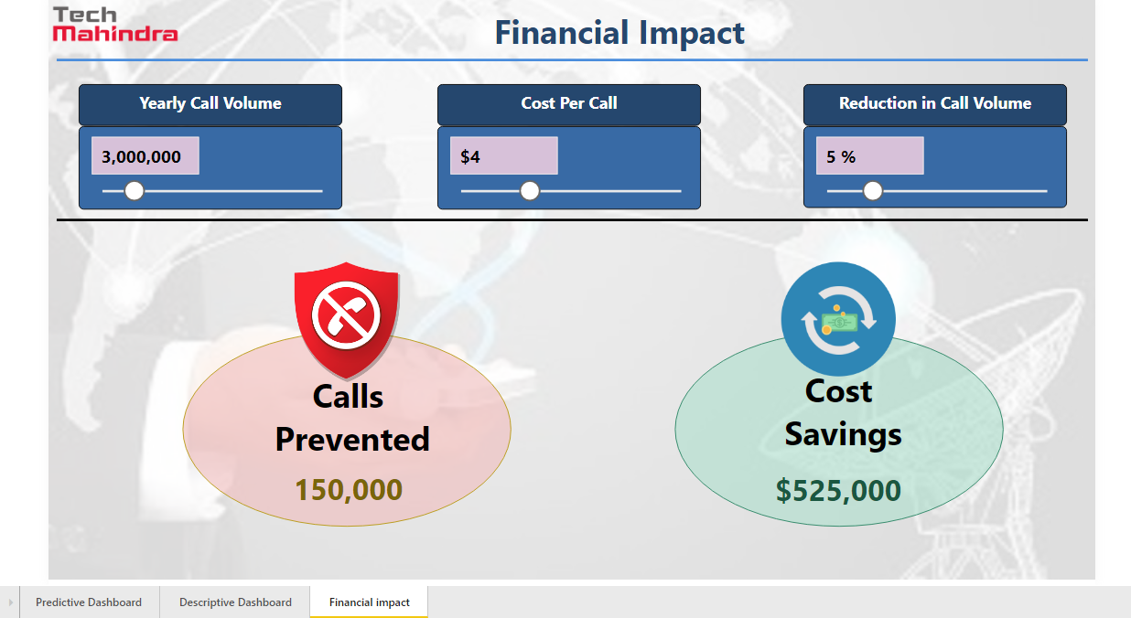

Slide 62
Thanks!!!

